Slide 1

A review of the main requirements of the IFS Logistics Standard
Vladimir Surčinski
FOOD SAFETY EXPERT, AUDITOR, TRAINER
Notes:
Hello, to all food safety friends. Thank you for logging in to this presentation, and thank you IFSQN for this great opportunity giving all of us place to share and to learn. Special thank to you Simon for beeing our host for this great webinars. Today we are going to talk about requirements of new ISO 22000:2018 and several steps you can easily implement in your business to comply with these requirements.

Slide 2




Vladimir Surčinski
2010
BY 2014
BY 2020
Quality & Sustainability Associate
Food Safety Operations Associate
Auditor
Trainer
Webinar presenter IFSQN
Food Safety Expert
-More than 500 food safety audits
-More than 1000 employees trained for food safety
-Development of food safety store auditing aplication tool
-Responsible for 3 countries and 362 stores at the time
-More than 300 audits of different standard
-Auditor for ISO 9001, 14001, OHSAS 18001, ISO 22000, FSSC 22000, HACCP, CEPA, RSPO
-Trainer for food safety standards – HACCP, ISO 22000, FSSC 22000, Global GAP
Emergency Preparedness and Response; Traceability of food in Restaurants and Fast Food; Safe Food vs Healthy Food;
- Regular calibration/training of food auditors
-Witness auditing of food auditors
Notes:
Practically you all know me from previous webinars since I started presenting for IFSQN from 2015. Till now we have talked about the topics of emergency preparedness, traceability of food in restaurants and fast foods, also interesting topics like Safe Food vs Healthy Food, we also among first on the internet covered topic of how industry should react in this time of COVID19.
I am certified Food Safety expert with more than 10 years in food safety topics through implementation, training and auditing business. Food safety standards are my focus, but still strongly included in standards for quality, environmental protection, health and safety, business continuity and risk assessment.
Currently on position of product manager for certification and trainings in food standards in certification body of Quality Austria were i am also accredited auditor and trainer with more than 500 audits performed in different industries and more than 1000 persons trained, even more trained through the online platforms.
I have a vision of finding a new ways to analyse risks in food safety and defining of methods that will be used in industries cross the world. My strategy is to develop and research new topics in food safety, presenting them through the webinars, training's, forums, blogging and publications. There is also new thing and from the beginning of the 2019 i started my own vide blog called addicetedtofoodvlog focused on food safety topics available on Linkedin, Instagram, FB and you tube.

Slide 3
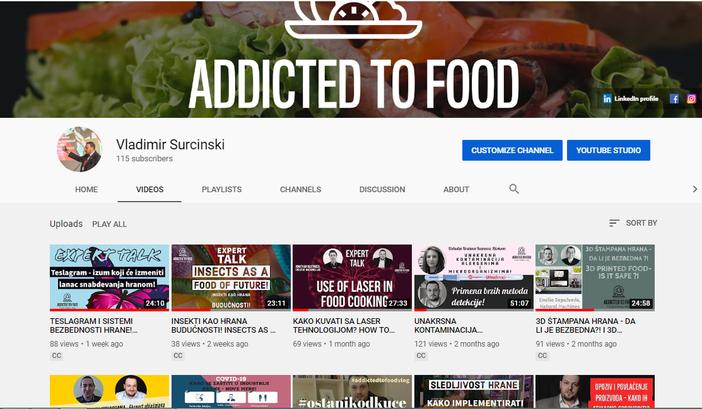

Slide 4
Are you already certified according to the IFS Logistic?
YES / NO
Notes:
So our first question today is already set up in the poll – Are you already certified according to the new version of ISO 22000:2018?

Slide 5
STORE

Slide 6


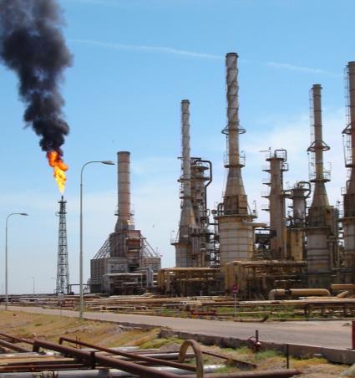
WORLD CHANGES
World trends that affect food industry changes
GLOBAL POPULATION
MIGRATIONS
NUTRITION
Population explosion
Conflicts over water, mineral resources, wood, pastures and arable land
Migration and urbanization
Terrorism, religious and clan warfare
1 billion of people that could be called migrants
Food migration needs
Employment in food productions
Soil erosion, water shortage
Malnutrition
Food pollution
Distribution and storage problems
Notes:
Todays food industry is change with the world trends that could be grouped in global population, migrations and nutrition. There are population explosion, conflicts, migrations, urbanization and on the other hand terrorism, religious and clan warfare in the world. All of this affects that there is 1 billion of people that could be called migrants. All of these people are accustomed to certain types of diet, types of food, and how they are prepared. Of course these people want to eat that kind of food in the countries where they migrated. Part of these people will get jobs in the food industries. Nutrition today is explained through malnutrition and food pollution including distribution and storage problems. And here taking into consideration all mentioned we must say that all big world crises started with the lack of food. Now we need to focus not only on production of needed amounts, but also on safety of these amounts.

Slide 7
WORLD CHANGES
2050: WORLD FOOD NEEDS WILL INCREASE 59-98%
World Population Expected to Hit 9.8 Billion by 2050
2061: 10 BN.
World Population in Billions
100
2039: 9 BN.
Average annual increase within 10 years
90
2024: 8 BN.
2011: 7 BN.
80
1999: 6 BN.
70
1987: 5 BN.
60
INCREASE IN MILLIONS
1974: 4 BN.
50
1959: 3 BN.
40
1927: 2 BN.
30
1804: 1 BN.
20
10
1700
1750
1800
1900
1950
2000
2050
2100
Source: United Nations, World Population Prospects (2013)
Notes:
If we look at the world population increase, it is expected to have more than 90 million of people in the world till 2050. This will increase food demands from 59-98%. For us food safety professionals that means that food safety must increase for at least 300%.

Slide 8
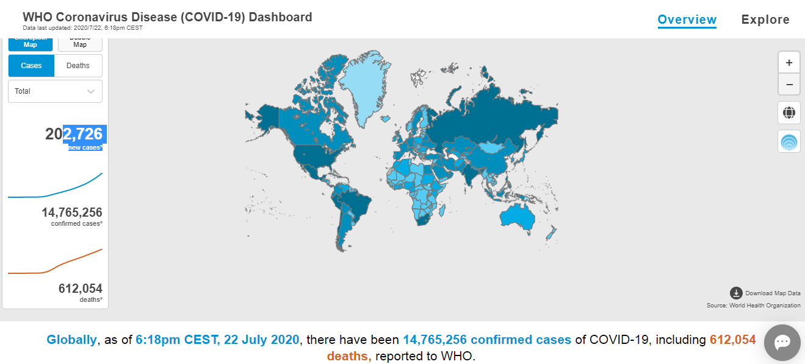

WORLD CHANGES
COVID-19 Pandemic Effects – older data
https://covid19.who.int/?gclid=CjwKCAjwx9_4BRAHEiwApAt0zpZRU3HGX-2nL8motapKY3h6wMv4O3zoGpnDl7wYZZl3yEsBNyDl0RoCHU4QAvD_BwE
Notes:
And we must mention the existing situation, existing pandemic that will influence food safety system. We mentioned in one of the previous webinars connected to COVID -19 that main process to be affected are food defence and food fraud. We were among the first ones to mention it, and we belive that there are more opportunities now, and easily need for food fraud to be done. For example, food chain is disrupted, there is lack of raw ingredinets, supstitution could happen without informing the consumer or regulative....this is something to discuise during the webinar today and furhter we will mention it on next slides.

Slide 9

Provide continuous improvement in food safety management systems to ensure confidence in the delivery of safe food to consumers worldwide..”
MISSION
GFSI
Safe food for consumers everywhere.”
VISION
GFSI

Slide 10
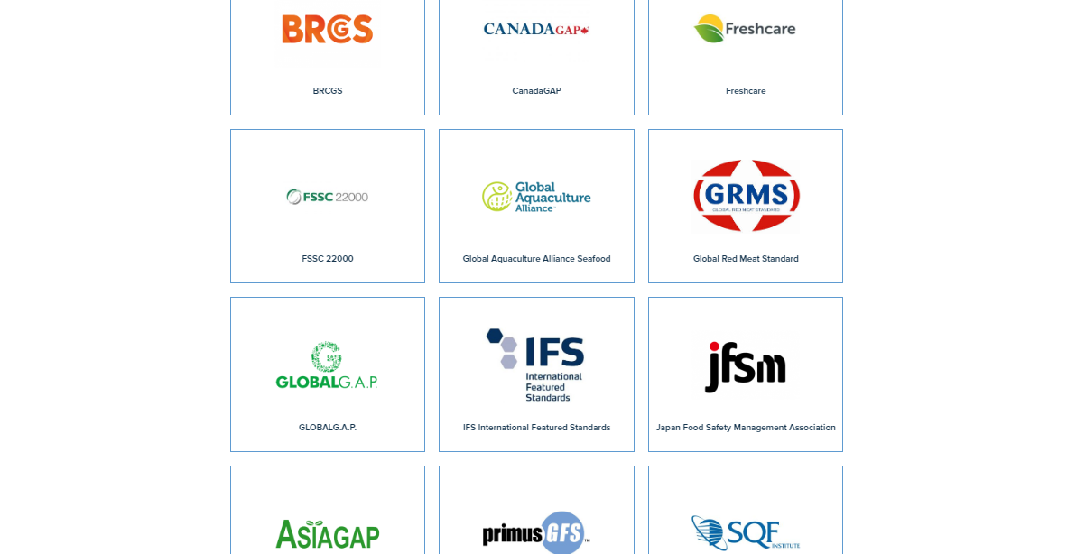
GFSI- Explore certification programmes

Slide 11
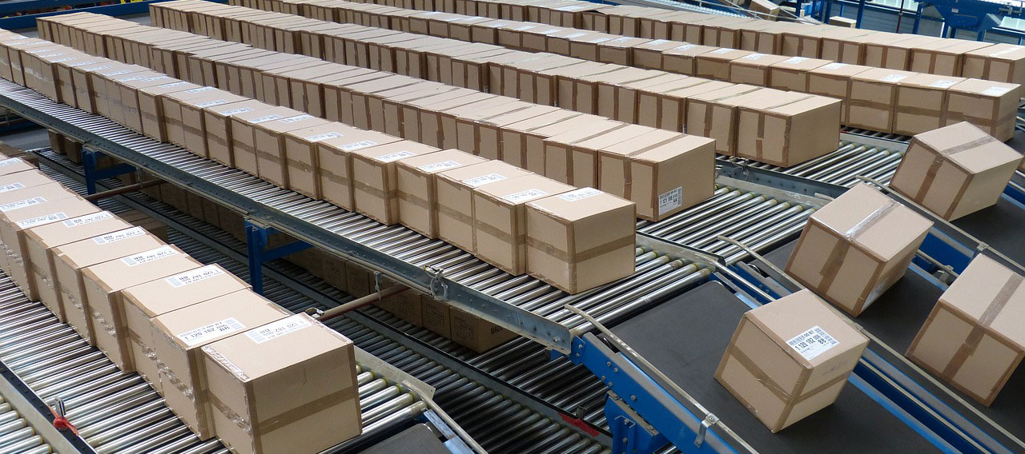

IFS LOGISTIC 2.2
SUPPLY CHAIN
application of standard
In order to prevent logistics companies from being overwhelmed by different requirements, the German and French retailers, supported by other international retailers, developed the IFS Logistics Version 1 in 2006. Version 2 was a collaboration of three retail federations from France, Germany and Italy and the IFS North America working group.
The IFS Logistics Standard applies to food and non-food products. The IFS Logistics includes all logistical activities like loading, transportation, off-loading, storage, handling and further distribution. The Standard is applicable for all types of transport: truck, train, ship, plane or any other types of transportation, temperature controlled or ambient stable.
Notes:
11
11

Slide 12

IFS Logistic 2.2
Objectives
to check the requirements for understanding
to adapt the Standard to meet current legislation
to include the Erratum
to include all IFS doctrines
to improve understanding of audit protocol
to specify the applicability for the logistical handling of unpacked food products (e.g. bread in boxes, meat carcasses) and nonfood products
to include specific requirements for freezing and thawing as a service
to update the Standard, in accordance with new version of GFSI
Guidance Document and benchmark procedure for storage and distribution standards.

Slide 13

Types of audit
An initial audit is a company’s first audit to IFS Logistics. It is performed at a time and date agreed between the company and the selected certification body. During this audit, the entire company is audited, both in relation to its documentation and the processes themselves. During the audit, all IFS requirements shall be assessed by the auditor.
A follow-up audit is required in a specific situation when the results of the audit (an initial audit or a renewal audit) have been insufficient to allow the award of the certificate. During the follow-up audit, the auditor focuses on the implementation of the actions taken to correct the Major non-conformity determined during the previous audit.
Renewal audits are those which are performed after the initial audit. The period in which a renewal audit shall be performed is shown on the certificate. A renewal audit involves a full and thorough audit of a company resulting in the issue of a new certificate. During the audit, all IFS requirements shall be assessed by the auditor.
If, between two certification audits, new products / services different from those included in the scope of the current IFS audit are added in the logistical services, the certified company shall immediately inform its certification body, who shall perform a risk assessment to decide whether an extension audit should be performed or not.
Notes:
13

Slide 14
IFS Logistic 2.2
Scope
IFS Logistics shall not apply to the following activities:
processing of food or non-food products (except for freezing and thawing processes, as a service; see Part 1, Annex 1)
importation, trading of goods (offices, e.g. typical broker companies with purchasing activities)
transportation of living animals.
The following scopes are defined for IFS Logistics audits:
1 Storage
a Food products
b Non-food products
2 Transport
a Food products
b Non-food products
Notes:
14

Slide 15
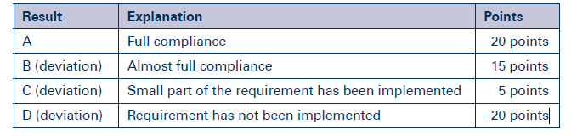
Audit
Evaluation of requirements
In IFS Logistics, there are 4 scoring possibilities:
Scoring with:
A: Full compliance with the requirement specified in the Standard
B: Almost full compliance with the requirement specified in the Standard,
but a small deviation was found
C: Only a small part of the requirement has been implemented
D: The requirement in the Standard has not been implemented
In addition to this scoring, the auditor can decide to give the company a “KO” or a “Major” non-conformity that will subtract points from the total amount.
Points are awarded for each requirement according to the following
chart:
Notes:
15

Slide 16

1 Senior management responsibility
IFS LOGISTIC 2.2

Slide 17
1. Senior management responsibility
1.1 Corporate policy / Corporate principles
1.1 Corporate policy / Corporate principles | YES | NO
1.1.1 "The senior management shall draw up and implement a clear corporate policy. This shall consider as a minimum: - product safety- customer focus - environmental responsibility - sustainability- personnel responsibility. The corporate policy shall be communicated to all employees. "
1.1.2 The content of the corporate policy shall have been broken down into measurable objectives (quality and product safety).
Notes – this slide is filled in during the food safety team meeting and discussion ! If requirement is not fulfilled 100% you will enter X at NO !

Slide 18
1. Senior management responsibility
1.2 Corporate structure | YES | NO
1.2.1 "An organisation chart shall be available showing the structure of the company. The organisation chart shall include, if applicable, the associated operating facilities (e.g. independent central warehouse(s), satellite depots and other locations where logistical activities are carried out)."
1.2.2 The department responsible for quality and product safety management and/or the IFS Logistics representative shall have a direct reporting relationship to the senior management.
1.2.3 The company shall assign responsibility for external communications (crisis management, authorities and communication with media) to a specific responsible person or persons.
1.2.4 Competences and responsibilities, including deputation of responsibility shall be clearly laid down.
1.2.5 The senior management shall ensure that employees are aware of their responsibilities related to product safety and quality. This shall be reviewed at least annually.
1.2.6 "The company shall have a system in place to ensure that it is kept informed of all relevant and current legislation. The legal requirements shall be implemented by the respective department(s)."
1.2.7 KO N° 1: Senior management shall be responsible for the corporate policy and objectives. The necessary resources and investments to ensure the product safety, legality and quality according to client agreements and specifications shall be provided.
Notes – this slide is filled in during the food safety team meeting and discussion ! If requirement is not fulfilled 100% you will enter X at NO !

Slide 19
1. Senior management responsibility
1.3 Customer focus | YES | NO
1.3.1 A documented procedure shall be in place to identify fundamental needs and expectations of customers.
1.3.2 The records of this procedure shall be evaluated and considered to determine quality and product safety objectives.
Notes – this slide is filled in during the food safety team meeting and discussion ! If requirement is not fulfilled 100% you will enter X at NO !

Slide 20
1. Senior management responsibility
1.4 Management review | YES | NO
1.4.1 "Senior management shall ensure that the quality and product safety management system is reviewed at least annually, or more frequently, if changes occur. Such reviews shall contain, as a minimum: results of audits customer feedbacks; status of preventative and corrective actions ; quality and product safety policy and objectives follow up actions from previous management reviews ; changes that could affect the product safety and quality management system and recommendations for improvement."
1.4.2 "The company shall identify and review regularly, but at least annually, the infrastructure needed to achieve conformity with product requirements(e.g. by internal audits or on-site inspection). This review shall include, e.g.: buildings, storerooms/ storage areas , storage facilities, machines and equipment, transport vehicles, transport units , transport containers. The results of the review shall be considered, with due consideration to risk, for investment planning."
1.4.3 "The company shall identify and review regularly, but at least annually, the work environment needed to achieve conformity with product requirements(e.g. by internal audits or on-site inspection).This review shall include as a minimum:– staff facilities– safety and security at work– hygienic conditions. The results of the review shall be considered, with due consideration to risk, for investment planning.
Notes – this slide is filled in during the food safety team meeting and discussion ! If requirement is not fulfilled 100% you will enter X at NO !

Slide 21
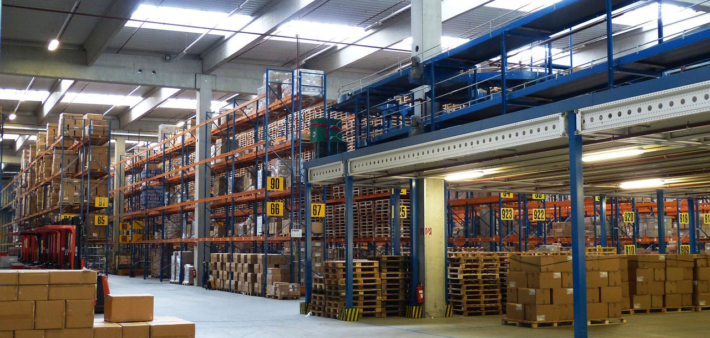
2. Quality and product safety management system
IFS LOGISTIC 2.2

Slide 22
2. Quality and product safety management system
2.1 Product safety management | YES | NO
2.1.1 KO N° 2: The basis of the company's product safety control system shall be a fully implemented, systematic and comprehensive risk management and/ or HACCP system. For food, an HACCP system shall be used and be based upon the Codex Alimentarius principles.
2.1.2 The risk management or HACCP system shall cover all product groups as well as every processes from goods receiving to dispatch and delivery.
2.1.3 The risk management/ HACCP system shall describe the differentiation between logistical handling of unpackaged and packed products and between temperature controlled and ambient stable products. The company’s own control system shall comply in relation to existing product risk.
Notes – this slide is filled in during the food safety team meeting and discussion ! If requirement is not fulfilled 100% you will enter X at NO !

Slide 23
2. Quality and product safety management system
2.2 Assemble risk management / HACCP team | YES | NO
2.2.1 The company shall have a risk management team or HACCP team, which is multidisciplinary. The team shall have strong senior management support and members of the team shall have detailed knowledge of activities across the whole facility.
2.2.2 The team leader shall be fully conversant in risk management and/ or HACCP principles and their application. The team leader shall be able to demonstrate that he/ she can identify, control and manage product safety hazards. Where there is deficiency regarding competency within the company, external expert advice shall be obtained.
Notes – this slide is filled in during the food safety team meeting and discussion ! If requirement is not fulfilled 100% you will enter X at NO !

Slide 24
2. Quality and product safety management system
2.3 Risk management / HACCP management | YES | NO
2.3.1 "The company shall clearly identify the scope of its responsibilities in the transport and logistics chain. The risk management/HACCP management shall be based on this scope."
2.3.2 Complete descriptions of services shall be available for all product groups and shall include relevant information concerning product safety, e.g. handling, storage, transport, delivery means and respective conditions.
2.3.3 A current version of the flow diagram shall be available for logistical and product specific services. In the event of any changes, the flow diagram shall be updated.
2.3.4 A hazard analysis shall be undertaken to evaluate all physical, chemical and biological hazards, including allergens, that may reasonably be expected to occur.
2.3.5 The hazard analysis shall consider the likely occurrence of hazards and severity of their adverse health effects. Where risk classification is used, a hazard analysis with risk assessment shall be documented for each risk class.
2.3.6 "For all steps/ processes that demand a specific control to ensure product safety, the company shall implement, maintain and document specific control measures (for food e.g. determination of CP/ CCP)."
2.3.7 For the specific control measures, the appropriate critical limits shall be defined (e.g. determination of critical limits for each CP/CCP).
2.3.8 KO N° 3 [NA possible]: Where risks need specific control to ensure product safety, a monitoring system for each CCP shall be implemented with clear critical limits and documentation system in place, in the event of loss of control.
Notes – this slide is filled in during the food safety team meeting and discussion ! If requirement is not fulfilled 100% you will enter X at NO !

Slide 25
How often do you verify HACCP in you company?
Type the answer in chat box
Notes:
So our first question today is already set up in the poll – Are you already certified according to the new version of ISO 22000:2018?

Slide 26
2. Quality and product safety management system
2.3 Risk management / HACCP management | YES | NO
2.3.9 In the event the monitoring of control points indicates that a critical limit is not under control (e.g. CP/ CCP), appropriate corrective actions shall be defined, taken and documented. Such corrective actions shall also take into account the control of any non-conforming products.
2.3.10 "Procedures of verification shall be established to confirm that the risk management/ HACCP system is effective. Verification of the system shall be performed at least annually. Examples of verification activities include, e.g.:– internal audits– evaluations– evaluation of complaints. The results of this verification shall be incorporated into the risk management/ HACCP system and shall be communicated to and reviewed by the senior management."
2.3.11 Documentation shall be available, covering relevant processes, procedures, measures and records. Documentation and record keeping shall be appropriate in relation to the nature and size of the company.
Notes – this slide is filled in during the food safety team meeting and discussion ! If requirement is not fulfilled 100% you will enter X at NO !

Slide 27
2. Quality and product safety management system
2.4 / 2.5 Documentation requirements / Record keeping | YES | NO
2.4.1 The system for product safety and quality management shall be documented, implemented and shall be retained in one location (safety and quality manual or electronic documented system). The reason for any amendments to documents critical for the product requirements shall be recorded.
2.4.2 "All necessary documents shall be available in their latest version. They shall be appropriately authorized and available to relevant personnel at all times. The documentation can be retained on hard copy or electronically. With respect to IT-based documentation, this shall be traceable to an authorizing signatory."
2.5.1 All relevant records, necessary for the product requirements shall be complete, detailed and maintained and shall be available on request.
2.5.2 "Records shall be legible and genuine. Any amendments to records shall only be carried out by authorized persons. If monitoring records are documented electronically, a system shall be in place to ensure that only authorized personnel have access to produce or amend these records(e.g. by the use of a password)."
2.5.3 All records shall be kept in accordance with legal requirements and at least for one year. Record keeping shall be based on a hazard analysis and associated risks. The records shall be securely stored and easily accessible.
Notes – this slide is filled in during the food safety team meeting and discussion ! If requirement is not fulfilled 100% you will enter X at NO !

Slide 28

3. Resource management
IFS LOGISTIC 2.2

Slide 29
3. Resource management
3.1 Personnel training / information | YES | NO
3.1.1 The company shall implement documented training and / or instruction programs. The training programs records shall include: training contents, training frequency (concerning food safety / hygiene at least once per year, for non-food once every two years is sufficient), employee’s task, list of participants, languages, qualified trainer / tutor, evaluation methodology (measurement of the effectiveness of the training and the training program). Before commencing work, basic product safety training shall take place.
3.1.2 The documented training programs and / or instruction shall apply to all personnel, including seasonal and temporary workers, employed in the respective work area.
Notes – this slide is filled in during the food safety team meeting and discussion ! If requirement is not fulfilled 100% you will enter X at NO !

Slide 30
3. Resource management
3.2 Personnel hygiene | YES | NO
3.2.1 "There shall be documented requirements relating to personnel hygiene, and where appropriate, the control of infection. These shall include, as a minimum:– hand washing and disinfection– eating and drinking– smoking– actions to be taken in case of cuts or skin abrasions. The requirements shall be based on hazard analysis and assessment of associated risks in relation to product and process."
3.2.2 The requirements for personnel hygiene shall be in place and applied by all relevant personnel, contractors and visitors. Compliance with the requirements shall be monitored and recorded.
3.2.3 The protective clothing for employees and visitors shall be appropriate, dependent on the product and process requirements.
3.2.4 "All protective clothing shall be thoroughly and regularly laundered. Hazard analysis and assessment of associated risks, together with consideration given to the processes and products of the company shall determine if clothing shall be washed by a contract laundry, on site laundry or by the employee."
Notes – this slide is filled in during the food safety team meeting and discussion ! If requirement is not fulfilled 100% you will enter X at NO !

Slide 31
3. Resource management
3.3 Sanitary facilities, equipment for personnel hygiene and staff facilities | YES | NO
3.3.1 The company shall provide staff facilities, which shall be proportional in size and equipped for the number of personnel. Such facilities shall be kept in clean and good condition to minimize product safety risks.
3.3.2 Adequate hand washing facilities shall be provided in the storage area and/ or the associated sanitary areas, based upon a hazard analysis and assessment of associated risks.
3.3.3 "Hand washing facilities shall provide as a minimum:– running potable water at an appropriate temperature,– liquid soap,– appropriate equipment for hand drying."
3.3.4 "Where highly perishable, unpackaged food products or sensitive products are handled, the following additional requirements regarding hand washing/ hygiene shall also be provided:– hand contact-free fittings– hand disinfection– adequate hygiene equipment's– signs requesting hand washing– waste container with hand contact-free opening."
Notes – this slide is filled in during the food safety team meeting and discussion ! If requirement is not fulfilled 100% you will enter X at NO !

Slide 32
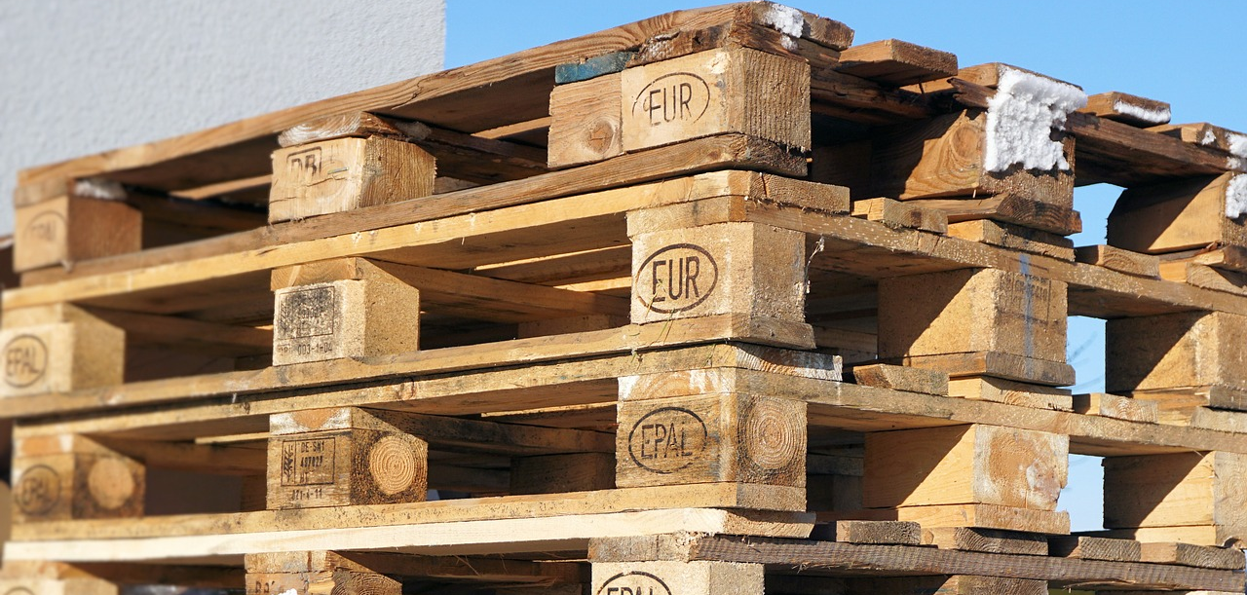
4 Realisation of the service
IFS LOGISTIC 2.2

Slide 33
4. Realisation of the service
4.1 General requirements for storage and transport
4.1.1 Contract review and communication | YES | NO
4.1.1 .1 The requirements and /or specifications which are defined between the contract partners shall be established, reviewed with regard to their acceptability and agreed upon before a supply agreement is concluded. All clauses related to quality and product safety shall be known and communicated to each relevant department.
4.1.1.2 Changes of existing contractual agreements shall be documented and communicated between the contract partners
4.1.1.3 If compliance to the agreed services is not possible (e.g. punctuality of delivery), the customer shall be informed promptly.
Notes – this slide is filled in during the food safety team meeting and discussion ! If requirement is not fulfilled 100% you will enter X at NO !

Slide 34
4. Realisation of the service
4.1 General requirements for storage and transport
4.1.2 Suppliers and service providers | YES | NO
4.1.2.1 There shall be a procedure for approval and monitoring of suppliers (internal and external) and service providers. The monitoring procedure shall include risk-based assessment criteria such as supplier reliability, complaints, audits, certificates of compliance as well as required performance standards.
4.1.2.2 The results of supplier’s assessments shall be reviewed regularly, but at least annually. There shall be records of the reviews and of the actions taken as a consequence of assessment.
4.1.2.3 A current list of approved suppliers and service providers shall be available to the personnel responsible for the management of service providers and suppliers.
Notes – this slide is filled in during the food safety team meeting and discussion ! If requirement is not fulfilled 100% you will enter X at NO !

Slide 35
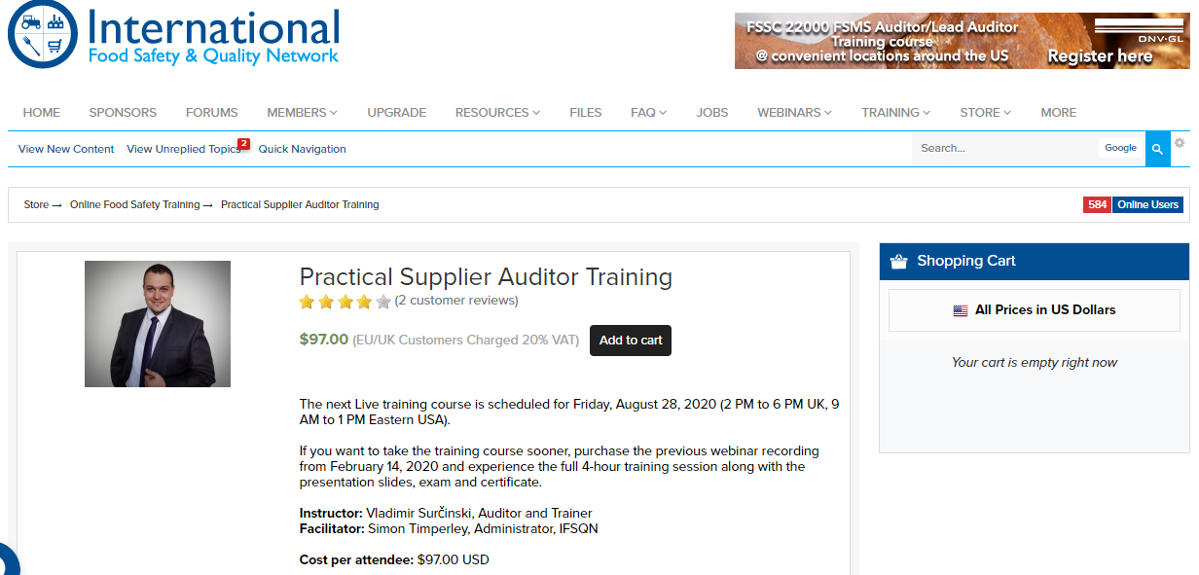
https://www.ifsqn.com/forum/index.php/store/product/78-practical-supplier-auditor-training/
Notes:
So our first question today is already set up in the poll – Are you already certified according to the new version of ISO 22000:2018?

Slide 36
4. Realisation of the service
4.1 General requirements for storage and transport
4.1.3 Specific requirements for material handling | YES | NO
4.1.3.1 The company shall have a procedure to avoid any contamination (also cross-contamination caused by incompatible products in the same transport unit or storage room). A contamination by emissions, exhaust fumes, smell, foreign bodies, packaging material and any other contaminants shall be avoided.
4.1.3.2 If the customer requirements include the requirement for the absence of defined ingredients (e.g. GMO, allergens), measures shall be in place to prevent cross contamination of unpacked products.
4.1.3.3 Specific demanded requirements regarding non-food product safety and/or protection of the environment (e.g. packing of damageable non-food products like electronic devices) shall be met.
Notes – this slide is filled in during the food safety team meeting and discussion ! If requirement is not fulfilled 100% you will enter X at NO !

Slide 37
4. Realisation of the service
4.1 General requirements for storage and transport
4.1.4 Traceability | YES | NO
4.1.4.1 A traceability system shall be in place and maintained, which is appropriate for the company and the products they handle.
4.1.4.2 The system shall ensure that the goods (incl. quantity) are identifiable within the defined logistical supply chain at all time. Furthermore, this system shall enable clear identification of every person and/or logistics company from which they receive the goods and to which company the goods are delivered to.
4.1.4.3 The company shall keep an updated register of all customers and quantity of the customer goods under their control. In the storage area, the products shall be assigned to a customer.
4.1.4.4 The traceability system shall be tested on a regular basis, but at least annually and each time the traceability system changes. This test shall be performed in order to confirm the effectiveness of the traceability system and to, if necessary, improve it. Test results shall be recorded and corrective measures shall be implemented, if required.
Notes – this slide is filled in during the food safety team meeting and discussion ! If requirement is not fulfilled 100% you will enter X at NO !

Slide 38
4. Realisation of the service
4.1 General requirements for storage and transport
4.1.5. Maintenance and repair | YES | NO
4.1.5.1 An adequate system of planned maintenance shall be in place, maintained and documented, covering all equipment (incl. transport) that is critical for compliance with product safety and quality requirements. This applies both for internal and external maintenance activities.
4.1.5.2 Product requirements and prevention of contamination shall be ensured during and after maintenance and repair work. Detailed records of maintenance and repair work, including corrective actions taken, shall be kept.
4.1.5.3 All materials used for maintenance and repair shall be fit for the intended use (e.g. food-grade oils, non-toxic paints if unpacked products are handled).
4.1.5.4 Failures of site and equipment covered by the maintenance system shall be documented and reviewed with a view to adapting the maintenance system.
Notes – this slide is filled in during the food safety team meeting and discussion ! If requirement is not fulfilled 100% you will enter X at NO !

Slide 39
4. Realisation of the service
4.1 General requirements for storage and transport
4.1.6. Air conditioning / cooling / water / ice and compressed air | YES | NO
4.1.6.1 Requirements for environmental control (e.g. temperature, humidity) which influence product quality and product safety shall be defined and implemented.
4.1.6.2 One or more appropriate temperature recording systems shall be implemented in the logistical chain in order to monitor the process at appropriate intervals.
4.1.6.3 Where the process requires air conditioning/ chilled air, the equipment used for this purpose shall be adequately maintained and cleaned within an appropriate frequency.
4.1.6.4 In case of breakdown of the air conditioning/ chilled system and/ or in the event of deviations from the target temperature, an alarm system shall be in place. Effective emergency corrective action procedures shall be in place ensuring product safety or quality is not compromised.
4.1.6.5 The use and storage of water and/ or ice that comes into direct contact with food and/ or food packaging shall be evaluated, based on hazard analysis and assessment of associated risks, in order to ensure that contamination is eliminated. Water and ice shall be of potable quality.
4.1.6.6 Where compressed air is used and has direct contact with food or food packaging, its use shall be evaluated based on hazard analysis and assessment of associated risks. The use of compressed air shall not compromise product safety or quality.
Notes – this slide is filled in during the food safety team meeting and discussion ! If requirement is not fulfilled 100% you will enter X at NO !

Slide 40
4. Realisation of the service
4.1 General requirements for storage and transport
4.1.7. Specific requirements in case of freezing and /or thawing processes | YES | NO
4.1.7.1 In case of freezing and/ or thawing services, there shall be a documented process which specifies hazard analysis, assessment of associated risks as well as appropriate measures to control identified risks.
4.1.7.2 In case of freezing and/ or thawing services, all details for processing and product parameters (e.g. time, temperature, extension or shortening of product-shelf life) shall be confirmed and agreed by the owner of the product.
4.1.7.3 In circumstances where the control of process and working environment parameters (e.g. temperature, time, pressure, chemical properties) is essential to ensure the product safety and quality requirements, such parameters shall be monitored and recorded continuously, or at appropriate intervals.
4.1.7.4 There shall be procedures in place to take corrective action in the event of equipment malfunction and/or process deviations.
Notes – this slide is filled in during the food safety team meeting and discussion ! If requirement is not fulfilled 100% you will enter X at NO !

Slide 41
4. Realisation of the service
4.1 General requirements for storage and transport
4.1.8. Cleaning and disinfection | YES | NO
4.1.8.1 Based on hazard analysis and assessment of associated risks, cleaning and disinfection schedules shall be established, implemented and documented. These shall specify: responsibilities of staff , the products used and their instructions for use, the areas to be cleaned and/or disinfected, objectives, cleaning frequency, documentation requirements hazard symbols (if necessary).
4.1.8.2 The effectiveness of the cleaning and disinfection measures shall be verified and documented. Resultant corrective actions shall be documented.
4.1.8.3 For transport containers (e.g. tankers, rail tankers), which are used for the transportation of liquid, granular and powdered unpackaged products, the following cleaning and disinfection measures shall be implemented, as a minimum: – the cleaning and disinfection measures shall be appropriate for the type of product – the cleaning and disinfection measures of the transport container shall include all associated working equipment (e.g., hoses, valves, strainers) – the cleaning and disinfection measures shall ensure that the transport container is clean, that unwanted substances are removed from the surfaces and the number of microorganisms are reduced to a level that is sufficiently low, depending on the intended use (cross-contamination is prevented) - objective evidence shall be available for the control of cleaning and disinfection measures of transport containers (e.g. records, certificates). The effectiveness of cleaning and disinfection measures shall be made known to the cleaning staff. The cleaning staff shall be trained in cleaning procedures.
Notes – this slide is filled in during the food safety team meeting and discussion ! If requirement is not fulfilled 100% you will enter X at NO !

Slide 42
4. Realisation of the service
4.1 General requirements for storage and transport
4.1.8. Cleaning and disinfection | YES | NO
4.1.8.4 The facility exterior shall be clean and in good condition.
4.1.8.5 Current Safety Data Sheets (SDS) and instructions for use shall be available on site for chemicals and cleaning agents. Instructions shall be known by the responsible personnel.
4.1.8.6 Cleaning utensils and chemicals shall be clearly labeled. These shall be stored and used in a way to avoid contamination
4.1.8.7 Where a company employs a third-party service provider for cleaning and disinfection activities, all requirements in 4.1.8 shall be clearly defined in the respective contract.
Notes – this slide is filled in during the food safety team meeting and discussion ! If requirement is not fulfilled 100% you will enter X at NO !

Slide 43
4. Realisation of the service
4.2 Storage and handling
4.2.1. Constructional requirements | YES | NO
4.2.1.1 The working environment shall not compromise product safety and/ or quality.
4.2.1.2 All working areas shall have adequate lighting.
4.2.1.3 The company shall control the risk of glass contamination. In areas where open products are handled, lighting equipment shall be protected by the use of shatter proof lights and installed to minimize the risk of breakage.
4.2.1.4 Procedure shall be in place describing the measures to be taken in case of breakage of glass and similar material. Such measures shall include: cleaning methods, avoiding of contamination, product quarantine (blocking/hold) and releasing.
4.2.1.5 The loading area shall be appropriate for its intended use. It shall be constructed in a way that: products are protected from rain, accumulation of waste is avoided, condensation and formation of mould growth is prevented, cleaning can be easily undertaken.
4.2.1.6 The floor, walls and ceilings shall be in good condition.
4.2.1.7 Windows, doors and gates shall be in good condition and shall be kept closed, if not used.
Notes – this slide is filled in during the food safety team meeting and discussion ! If requirement is not fulfilled 100% you will enter X at NO !

Slide 44
4. Realisation of the service
4.2 Storage and handling
4.2.2. Equipment | YES | NO
4.2.2.1 All equipment shall be designed for its intended use, maintained and stored not to pose any product safety or quality risk.
4.2.2.2 The utilities and other equipment (cables, switches, etc.) shall be easily accessible for cleaning.
4.2.2.3 Work equipment, which are being used, shall be designed so that possible damage and/ or contamination is prevented.
Notes – this slide is filled in during the food safety team meeting and discussion ! If requirement is not fulfilled 100% you will enter X at NO !

Slide 45
4. Realisation of the service
4.2 Storage and handling
4.2.3. Pest monitoring / pest control | YES | NO
4.2.3.1 The company shall have a pest control system in place which is in compliance with local legal requirements and shall have, as a minimum, criteria for: the site environment (potential pests), site plan with area for application (bait map),identification of the baits on-site, responsibilities (in-house/external), products/agents and their instructions for use and safety the frequency of inspections. The pest control system shall be based on hazard analysis and assessment of associated risks.
4.2.3.2 The company shall have qualified and trained in-house staff, and/ or employ the services of a qualified external provider. Where an external provider is used, the activities required on site shall be laid down in a written contract.
4.2.3.3 Following pest control inspections, any resulting recommendations shall be acted upon by both parties and actions shall be documented, including the date when corrective actions were taken. The products used for pest control shall not compromise product safety. The effectiveness of the pest control shall be monitored and regular trend analyses undertaken.
4.2.3.4 Incoming deliveries shall be checked on arrival for the presence of pests. Any infestation shall be documented and control measures taken.
4.2.3.5 Products, equipment and transportation vehicles shall be stored so as to minimize the risk of pest infestation. Where stored product and/or machines may attract pests, appropriate measures shall be taken to prevent risk of contamination.
Notes – this slide is filled in during the food safety team meeting and discussion ! If requirement is not fulfilled 100% you will enter X at NO !

Slide 46
4. Realisation of the service
4.2 Storage and handling
4.2.4. Receipt of goods and storage | YES | NO
4.2.4.1 Procedures for the receipt of goods shall be established, effectively implemented and communicated to all relevant personnel. These procedures shall include general checking criteria (e.g. identification of products and vehicle), rules for goods acceptance, goods rejection and qualified acceptance. Non-conformities shall be acted upon and documented. If specific product checks are requested by the customer, they shall be implemented and known by the responsible employees.
4.2.4.2 All products shall be clearly identifiable at all times. Storage, removal and handling of the goods shall be in accordance with customer requirements.
4.2.4.3 Effective stock control system shall be in place and may include methods such as, First In - First Out (FIFO) or First Expired - First Out (FEFO) and shall meet customers requirements,
4.2.4.4 The loading and unloading of product shall be carried out in a manner which prevents damage. The product shall be secured so that contamination and/ or damage is prevented during transport.
4.2.4.5 The staff shall be trained in the safe handling and security of product at all times, e.g. during loading, unloading and whilst in storage.
Notes – this slide is filled in during the food safety team meeting and discussion ! If requirement is not fulfilled 100% you will enter X at NO !

Slide 47
4. Realisation of the service
4.2 Storage and handling
4.2.4. Receipt of goods and storage | YES | NO
4.2.4.6 Outdoor storage shall be kept to a minimum. Where goods are stored outside, hazard analysis and assessment of associated risks shall be undertaken in order to ensure that there is no risk of contamination or adverse effect on quality and product safety.
4.2.4.7 Where pallets are used, these shall be inspected to ensure they are in good condition and shall not compromise product safety.
4.2.4.8 A hazard analysis and assessment of associated risks for possible food fraud is in place, which realistically can be expected within the process. Based on this, appropriate measures for risk mitigation shall be documented and implemented, if necessary. - https://www.ifs-certification.com/images/standards/ifs_food6/documents/FoodFraud-Guide_1805.pdf
Notes – this slide is filled in during the food safety team meeting and discussion ! If requirement is not fulfilled 100% you will enter X at NO !

Slide 48
4. Realisation of the service
4.2 Storage and handling
4.2.5. Waste disposal | YES | NO
4.2.5.1 All current legal requirements for waste disposal shall be met.
4.2.5.2 Food waste and other waste shall be removed from areas where food and/ or sensitive goods are handled and pose a risk to product safety and quality.
4.2.5.3 Waste collection containers shall be clearly marked and in a proper condition.
4.2.5.4 Waste shall be collected in separate containers in accordance with the intended means of disposal. Such waste shall be disposed by authorized third parties only. Records of waste disposal shall be kept by the company..
Notes – this slide is filled in during the food safety team meeting and discussion ! If requirement is not fulfilled 100% you will enter X at NO !

Slide 49
4. Realisation of the service
4.2 Storage and handling
4.2.6. Storage service providers | YES | NO
4.2.6.1 Where a company employs a third-party storage service provider, all the requirements specified within section 4.1, 4.2 and 5.3 shall be clearly defined in the respective contract or the service provider shall be certified according to IFS Logistics requirements.
4.2.6.2 The employees of the service provider shall understand and apply the personnel hygiene requirements of the company.
Notes – this slide is filled in during the food safety team meeting and discussion ! If requirement is not fulfilled 100% you will enter X at NO !

Slide 50
4. Realisation of the service
4.3 Transport
4.3.1. Specific transport requirements | YES | NO
4.3.1.1 Transport vehicles, transport units, and/ or transport containers that are being operated on different modes of transport (street, rail, air and water) shall keep the transport conditions of the goods being transported within the boundaries of the permissible tolerance (e.g. temperature).
4.3.1.2 Where goods must be transported at defined conditions (e.g. temperature), the conditions inside the vehicle shall be checked before loading and documented to ensure compliance with the specified conditions.
4.3.1.3 When temperature controlled goods are being stored or transported in containers (e.g. thermal boxes), these containers shall be in good condition (clean, odour free, dry, functional and fit for purpose). Prior to loading of the product in these transport containers, the containers shall be precooled.
4.3.1.4 During transport, the respective permissible load level (payload) of transport vehicles, transport units and/ or containers shall not be exceeded, in order to maintain product safety and quality.
4.3.1.5 Transport containers (e.g. tankers, rail tankers), which are used for the transportation of liquid, granular and/ or powdered unpackaged food products shall be labeled and used exclusively for the transportation of food.
4.3.1.6 Cleaning of the transport unit shall be performed with consideration of the specific hygienic requirements and product risks. Cleaning certificates or other objective evidence that effective cleaning has been carried out shall be available, if required by law or by the customer(s).
Notes – this slide is filled in during the food safety team meeting and discussion ! If requirement is not fulfilled 100% you will enter X at NO !

Slide 51
4. Realisation of the service
4.3 Transport
4.3.1. Specific transport requirements | YES | NO
4.3.1.7 Hoses, pumps, filters of tankers (tank-containers, etc.) shall be in good condition and protected from contamination during transport.
Notes – this slide is filled in during the food safety team meeting and discussion ! If requirement is not fulfilled 100% you will enter X at NO !

Slide 52
4. Realisation of the service
4.3 Transport
4.3.2. Transport service providers | YES | NO
4.3.2.1 Where a company uses a third-party transport service provider on a regular basis, all the requirements specified within section 4.1, 4.3 and 5.3 shall be clearly defined in the respective contract or the service provider shall be certified according to IFS Logistics.
4.3.2.2 The drivers of the service provider shall know and apply the personnel hygiene requirements.
4.3.2.3 Where a company uses a third-party service provider on an irregular basis for the transport of packed products (spot market), the service provider shall be certified according to IFS Logistics or fulfill the following evidently and binding agreed requirements: – the transport units and truck shall be clean - the service provider shall ensure temperature of product is controlled – different products shall clearly separated – there shall be absence of smells and other contamination (4.1.3.1) – requirement 4.1.1.3 shall be fulfilled – requirement 5.3 shall be fulfilled – requirements 5.6 shall be fulfilled. If the product is forwarded to another service provider, these defined requirements shall be met.
Notes – this slide is filled in during the food safety team meeting and discussion ! If requirement is not fulfilled 100% you will enter X at NO !

Slide 53
5. Measurements, analysis, improvements
IFS LOGISTIC 2.2

Slide 54
5. Measurements, analysis, improvements
5.1 Internal audits
5.1. Internal audits | YES | NO
5.1.1 KO N° 4: Effective internal audits shall be conducted according to a defined agreed audit program and shall cover all requirements of IFS Standard. Scope and frequency of internal audits shall be determined by hazard analysis and assessment of associated risks. This criteria is also applicable for off-site locations owned or rented by the company.
5.1.2 Internal audits of activities which are critical to product safety shall be carried out at least once a year.
5.1.3 The auditors shall be competent and independent from the audited department. If the product is forwarded to another service provider, these defined requirements shall be met.
5.1.4 Audit results shall be communicated to the senior management and to responsible persons of relevant departments. Necessary corrective actions and a schedule for implementation shall be determined. All corrective actions shall be undertaken, documented and communicated to every relevant person.
5.1.5 It shall be documented, how and when the corrective actions resulting from the internal audits shall be verified.
Notes – this slide is filled in during the food safety team meeting and discussion ! If requirement is not fulfilled 100% you will enter X at NO !

Slide 55
5. Measurements, analysis, improvements
5.2 Site inspections
5.2. Site inspections | YES | NO
5.2.1 Site inspections shall be planned and carried out, based on hazard analysis and assessment of associated risks. In addition to the infrastructure of the site (see 1.4.2 and 1.4.3), the operational aspects of personnel hygiene, hygiene of the process, the HACCP/ risk management system and food defense shall be evaluated.
5.2.2 Any discrepancies found from the site inspections as well as corresponding corrective action shall be recorded. The corrective actions shall be implemented.
Notes – this slide is filled in during the food safety team meeting and discussion ! If requirement is not fulfilled 100% you will enter X at NO !

Slide 56
5. Measurements, analysis, improvements
5.3 Calibration, adjustment and checking of measuring and monitoring devices
5.3. Calibration, adjustment and checking of measuring and monitoring devices | YES | NO
5.3.1 The company shall identify the measuring and monitoring devices required to ensure compliance with product requirements. These devices shall be recorded on a document and clearly identified.
5.3.2 The measurement equipment and devices shall be checked, calibrated and/or verified and/or adjusted at defined intervals and against recognised standards/methods (if appropriate). The results of checks, adjustments and/or calibration shall be documented.
Notes – this slide is filled in during the food safety team meeting and discussion ! If requirement is not fulfilled 100% you will enter X at NO !

Slide 57
5. Measurements, analysis, improvements
5.4 Management of complaints
5.4. Management of complaints from authorities and customers | YES | NO
5.4.1 A system shall be in place for the management of product complaints
5.4.2 All complaints shall be assessed by competent staff. Where it is justified, appropriate actions shall be taken, if necessary, as soon as practicable.
5.4.3 Complaints shall be analysed with a view to implementing preventative actions, which avoid the recurrence of the non-conformity.
5.4.4 The results of complaint data analysis shall be made available to the relevant responsible persons and to the senior management.
Notes – this slide is filled in during the food safety team meeting and discussion ! If requirement is not fulfilled 100% you will enter X at NO !

Slide 58
5. Measurements, analysis, improvements
5.5 Management of non-conformities and nonconforming products
5.5. Management of non-conformities and nonconforming products | YES | NO
5.5.1 KO N° 5: An effective procedure shall be in place for the management of all non-conforming products.
5.5.2 The procedure for the management of non-conforming products shall include, as a minimum: – hazard analysis and assessment of associated risks – procedure of product quarantine (blocking/hold) – identification (e.g. labeling) – clearly identified staff responsibilities – the release procedure of goods.
5.5.3 The procedure for the management of non-conforming products shall be understood by all relevant employees.
5.5.4 Where non-conformities are identified, immediate corrections shall be taken to ensure that product requirements are complied with.
5.5.5 The effectiveness and timeliness of implementation of the procedure for managing non-conforming products shall be subject to internal testing at least annually, (where quarantine has taken place within a year, this shall be used to assess the procedure). This assessment shall be carried out in a manner to ensure the effective implementation and operation of the procedure.
Notes – this slide is filled in during the food safety team meeting and discussion ! If requirement is not fulfilled 100% you will enter X at NO !

Slide 59
5. Measurements, analysis, improvements
5.6 Recall and withdrawal
5.6. Recall and withdrawal | YES | NO
5.6.1 There shall be an effective procedure for the withdrawal and recall of all products. This procedure shall include a clear assignment of responsibilities.
5.6.2 The procedure shall ensure an effective and prompt response to recall and withdrawal requirements of the product owner.
5.6.3 To ensure its effectiveness and possible improvement, the procedure shall be tested at least annually. If a product recall or withdrawal has taken place within the last 12 months, this may be used to assess the procedure.
Notes – this slide is filled in during the food safety team meeting and discussion ! If requirement is not fulfilled 100% you will enter X at NO !

Slide 60
5. Measurements, analysis, improvements
5.7 Crisis and incident management
5.7. Crisis and incident management | YES | NO
5.7.1 A documented procedure shall be established for the management of incidents and of potential emergency situations, that impact product safety, legality and quality. This procedure shall be implemented and maintained. The procedure shall include as a minimum: the nomination and training of a crisis team, an alert contact list, sources of legal advice (if necessary), contacts availability, customer information and a communication plan.
5.7.2 The feasibility, effectiveness and timeliness of implementation of the procedure for management of incidents shall be subject to regular internal testing, at least annually.
Notes – this slide is filled in during the food safety team meeting and discussion ! If requirement is not fulfilled 100% you will enter X at NO !

Slide 61
5. Measurements, analysis, improvements
5.8 Corrective actions
5.8. Corrective actions | YES | NO
5.8.1 A procedure shall be in place for the recording and analysis of the non-conformities with the objective to avoid recurrences by preventative actions and/or corrective actions.
5.8.2 KO N° 6: Corrective actions shall be clearly formulated, documented and undertaken, as soon as possible, to avoid further occurrence of non-conformity. The responsibilities and the timescales for corrective action shall be clearly defined.
5.8.3 The performance of the implemented corrective actions shall be documented and the effectiveness shall be checked.
5.8.4 The preventative and corrective actions shall be communicated to the senior management.
Notes – this slide is filled in during the food safety team meeting and discussion ! If requirement is not fulfilled 100% you will enter X at NO !

Slide 62
6. Product / food defense plan and external inspections
IFS LOGISTIC 2.2

Slide 63
6. Product / food defense plan and external inspections
6.1 Defense assessment
6.1 Defense assessment | YES | NO
6.1.1 Responsibilities for product/ food defense shall be clearly defined. The person responsible for product/ food defense shall be part of key staff or shall have access to the top management team. Knowledge in this area shall be demonstrated by the responsible person.
6.1.2 A product defense hazard analysis and assessment of associated risks shall have been performed and documented. Based on this assessment and legal requirements, areas critical to security shall be identified. Product defense hazard analysis and assessments of associated risks shall be conducted annually or upon changes that affect product integrity. An appropriate alert system shall be defined and periodically tested for effectiveness. - https://www.ifs-certification.com/images/standards/ifs_food6/documents/IFS_Food_DefenseGL_eng_web.pdf
6.1.3 If legislation makes registration or on-site inspections necessary, evidence of compliance shall be provided.
Notes – this slide is filled in during the food safety team meeting and discussion ! If requirement is not fulfilled 100% you will enter X at NO !

Slide 64
6. Product / food defense plan and external inspections
6.2 Site security | YES | NO
6.2.1 Based on a hazard analysis and assessment of associated risks, identified areas critical to security shall be adequately protected to prevent unauthorized access. Access points shall be controlled.
6.2.2 Procedures shall be in place to prevent and identify signs of tampering.
Notes – this slide is filled in during the food safety team meeting and discussion ! If requirement is not fulfilled 100% you will enter X at NO !
6.3 Personnel and visitor security | YES | NO
6.3.1 Visitor policy shall contain specific aspects of product defense plan. Delivery and loading staff in contact with the product shall be identified and shall respect the access rules of the company. Visitors and external service providers shall be identified in areas with product storage and shall be registered at the time of access. They should be informed about the site policies and their access controlled accordingly.
6.3.2 All employees shall be trained in product defense with respect to the product requirements and the training needs of the emloyees or when significant program changes occur. The training sessions shall be documented. Employee hiring and employment termination practices shall consider security aspects as permitted by law.
Notes – this slide is filled in during the food safety team meeting and discussion ! If requirement is not fulfilled 100% you will enter X at NO !

Slide 65
6. Product / food defense plan and external inspections
6.4 External inspections | YES | NO
6.4.1 A documented procedure shall exist for managing external inspections and regulatory visits. Relevant personnel shall be trained to execute the procedure.
Notes – this slide is filled in during the food safety team meeting and discussion ! If requirement is not fulfilled 100% you will enter X at NO !

Slide 66
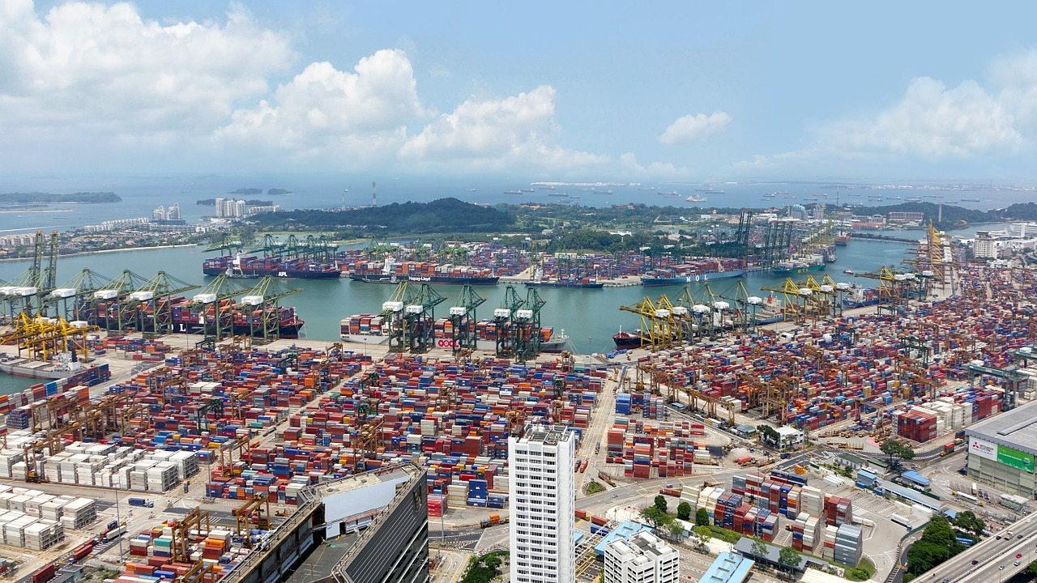
Thank you
Vladimir Surčinski
vladimir.surcinski@addictedtofood.me
vladimir.surcinski@qualityaustria.rs
#addictedtofoodvlog
https://www.linkedin.com/in/vladimirsurcinski/
https://www.facebook.com/addictedtofoods
https://www.instagram.com/addictedtofoodvlog/
IFS LOGISTIC 2.2 Main requirements

